Slide 1
2016 USATF Annual Meeting
Hilton at Walt Disney World
National Officials Clinic
EFFICIENT CLERKING
Clinic E December 3, 2016
Jim Smyth and Lloyd “Bert” Garcia
Notes:
Clerk of Course

Slide 2
CLINIC OVERVIEW
Personnel and Duties
Facilities, Equipment, and Supplies
Pre-Competition Duties
Competition Duties
Post-Competition Duties
Proactive Clerking
Resources
Discussion
NOTE: Presentation based on track events. However, at national level meets the clerk checks in and stages athletes participating in field events.
Notes:
Clerk of Course

Slide 3
CLERK OF COURSE
Maintains time schedule
Verifies entries
Ensures athletes run in correct races & lanes
Instructs athletes relative to their events
Delivers athletes to starting line
Places athletes in proper starting positions
Places relay teams in proper positions
Enforces uniform, shoe, and logo rules
See: USATF Officials Best Practices
Notes:
Clerk of Course

Slide 4
CLERKING TERMS
Call Room - Used for competitor check-in
Staging Area – Used to organize races/instruct runners
Escorting – Taking athletes to the starting line
Escort Paddock – Area used for final assembly of races
Heat Sheets – Athletes, race/heat, lane positions
Bibs – Identification number assigned to each athlete
Hip Numbers – Used to indicate lane/starting position
Calls – Announcements on when to report to clerk
Warm-Up Area – Used for final warm-up
Notes:
Clerk of Course

Slide 5
PERSONNEL AND DUTIES
Positions
  Chief Clerk
  Assistant Clerk
  Escort Clerk
  Line Clerk
  Volunteers
Number of Clerks Required
  Local Meets
  Conference Championship Meets
  USATF and NCAA Championship Meets
Notes:
Clerk of Course

Slide 6
FACILITIES
Clerking Stations
  Meet Registration
  Call Room/Check-In
  Staging Area
  Escort Paddock
Primary Considerations
  Visibility and Access
  Sufficient Space
  Number of Athletes Competing
  Routes to Event Sites
  Location of Event Sites
Notes:
Clerk of Course

Slide 7
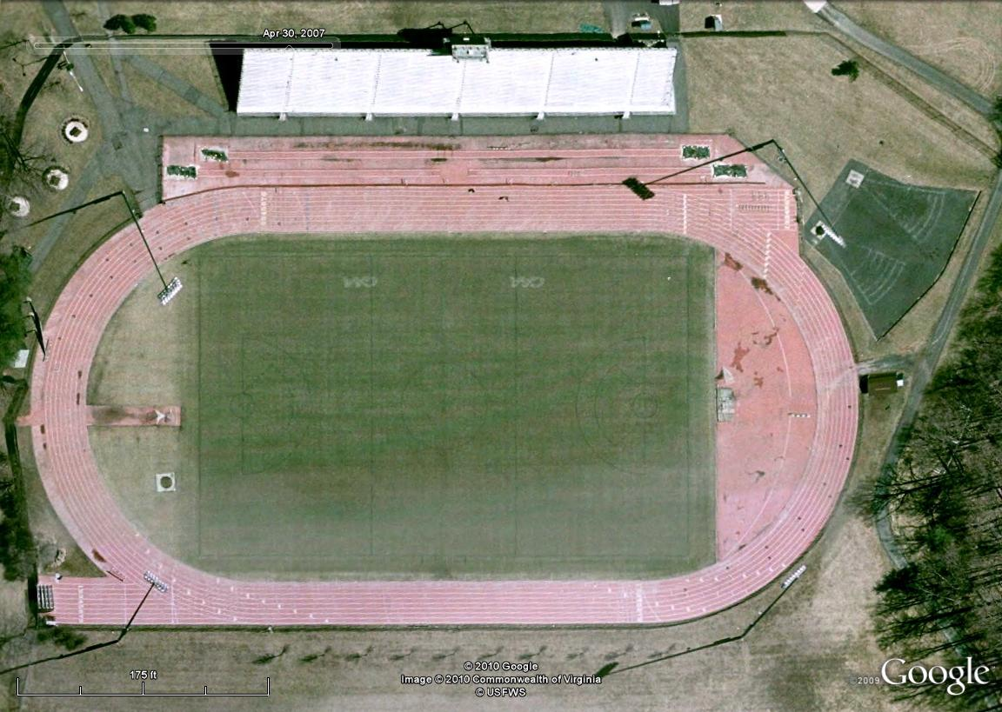
FACILITIES
POLE VAULT
CLERK
TIMING
George Mason
NOTE: Indoor Track serves as warm-up area.
Notes:
Clerk of Course

Slide 8
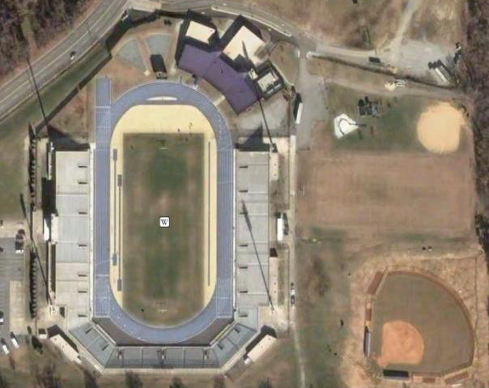
FACILITIES
North Carolina A&T
WARM-UP
AREA
STAGING
TRACK
CHECK-IN
FIELD
CHECK-IN
Notes:
Clerk of Course

Slide 9
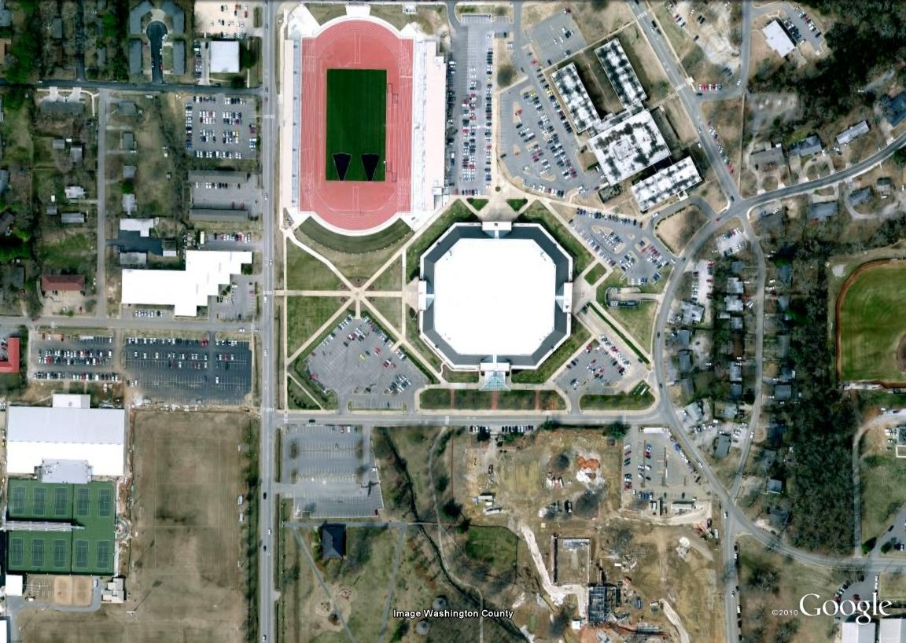
FACILITIES
STAGING AREA
CHECK-IN
(Track & Field)
WARM-UP
AREA
Arkansas
Notes:
Clerk of Course

Slide 10
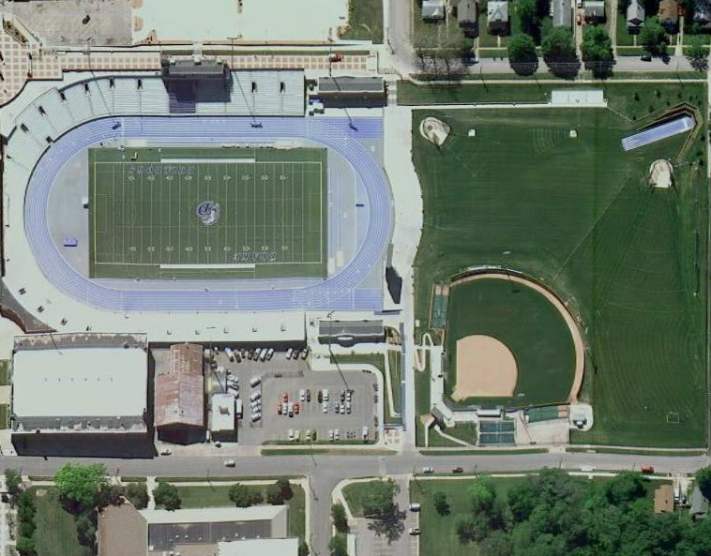
FACILITIES
Drake
CHECK-IN
(Track & Field)
WARM-UP
AREA
STAGING AREA
Notes:
Clerk of Course

Slide 11
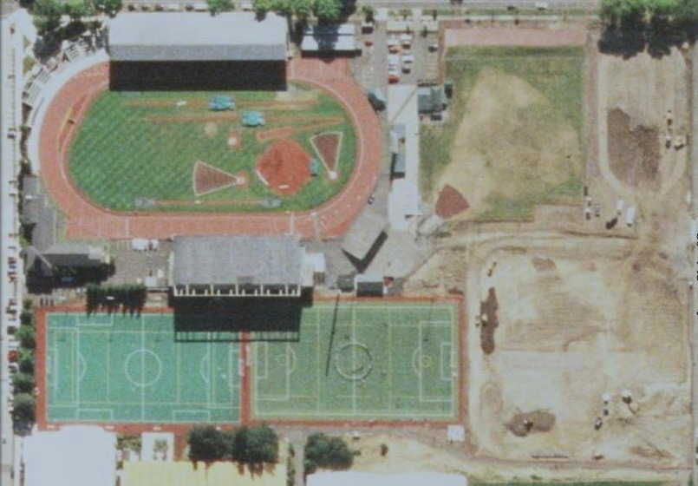
FACILITIES
Oregon
FINAL STAGING
(Under Stands)
CHECK-IN
AND
INITIAL STAGING
WARM-UP
AREA
Notes:
Clerk of Course

Slide 12



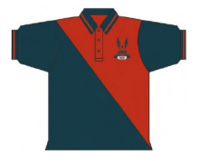








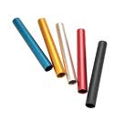
















EQUIPMENT AND SUPPLIES
CLERK
Notes:
Clerk of Course

Slide 13
PRE-COMPETITION DUTIES
Obtain schedule of events (any changes?)
Obtain heat sheets
Obtain hip numbers, extra bibs, and supplies
Obtain communication device and PA system
Inspect areas of safety
Set up clerking facilities
Put up signs and schedule
Establish check-in procedures
Meet with other clerks and assign duties
See: USATF Officials Best Practices
Notes:
Clerk of Course

Slide 14
PRE-COMPETITION DUTIES
Assemble packets of heat sheets and hip numbers
Walk track (start, finish, break-in, and relay zones)
Establish escort routes
Meet with Timing Crew (hip numbers and placement)
Coordinate with Announcer on calls
Meet with Meet Director and Referee
  Verify rules being used (NO local exceptions)
  Verify advancement procedures
  Verify location of Referee
Meet with Starter and Finish Line Coordinator
See: USATF Officials Best Practices
Notes:
Clerk of Course

Slide 15
COMPETITION DUTIES
Check-In: Check bib, spikes, uniforms; heat & lane assignments; report back time
Staging: Hipping, start/break lines, starter commands, advancement
Escorting: Keep control, when/where for strides
Line Clerking: Position runners, sweats off, stand behind blocks or behind starting line
See: USATF Officials Best Practices
Notes:
Clerk of Course

Slide 16
CHECK-IN DUTIES
Arrive early
Organize table(s) by gender/event and spread out heat sheets
Method of noting athletes who check-in/scratch (unique mark)
Verify competition number, name, and school
Inform athletes of their heat, section, and lane assignments
Inform athletes of their race time and when to report to staging area
Check for compliance with uniform, logo, shoe/spike rules
Issue hip numbers and where to be placed (at smaller meets)
Be informed of general information on the meet and event site
Be aware of the progress of the meet and advise athletes of delays
Inform Chief Clerk of any scratches that affect rounds or heats
Collect relay cards (verify names, bibs, order, and uniforms)
Be professional and help athletes
See: USATF Officials Best Practices
Notes:
Clerk of Course

Slide 17
STAGING DUTIES
Obtain heat sheets from check-in clerk
Verify who is present, give heat, section, and lane assignments
Check competition numbers, and issue hip numbers (at larger meets)
Be sure that bibs and hip numbers are worn correctly
Inform athletes of advancement procedures
Inform athletes of location of starting, break, and finish lines
Inform athletes of starting procedures
Note any late scratches
Inform athletes of time to start and when will leave staging area
Keep athletes in staging area or nearby warm-up area
See that information on any scratches is delivered to announcer
Verify relay cards for changes (keep or deliver to announcer)
Make a unique mark on heat sheet of athletes who report back in
Inform athletes what they can and cannot take with them
Notes:
Clerk of Course

Slide 18
ESCORTING DUTIES
Likely that clerks staging the athletes will also escort them to the start
Take the heat sheet with you when escorting the athletes
Call out names or check the number to be sure that all leave the area
If someone is not present, make arrangements for a separate escort
Escort athletes to the starting line in prearranged route
Check for hip numbers, and have extra hip number and pins
Deliver athletes to the Line Clerk
Inform Line Clerk and Timing Group of all scratches
Stay in area to record any last minute scratches or to assist as needed
Upon returning to Clerking area, retain heat sheets for documentation
Escort relay team members to exchange zones (often just send them)
As needed, record names of athletes who failed to participate (NCAA)
Notes:
Clerk of Course

Slide 19
LINE CLERK DUTIES
Verify competitors, heat/section, and lane assignments
Check for hip numbers (have extra hip number and pins ready)
Provide or remind runners of final race instructions*
Provide or remind athletes of advancement procedures*
Inform athletes of any delays or special situations regarding race (TV)
Position each runner in proper starting location
Place and control other relay team members (usually if zone near start)
Assist starters in re-positioning runners if there is a false start
Control runners in other heats
* For national level meets, detailed instructions, and addressing questions,
should take place in the staging area.
Notes:
Clerk of Course

Slide 20
POST-COMPETITION DUTIES
Clean up clerking areas
Return heat sheets for documentation
Return unused hip numbers and bibs
Return any communication devices
Return any equipment and supplies
Take down signs
Thank other clerks and volunteers
Thank other officials
Notes:
Clerk of Course

Slide 21

USATF RULES
Rule 138: Clerking Duties
Rule 142: Competitor Check-In
Rule 143: Athletic Attire
Rule 166.1: Forming Heats
Rule 166.2: Heats Not Needed
Rule 166.3: No Competition
Rule 166.5: L ate Reporting
Primary Clerking Rules
Notes:
Clerk of Course

Slide 22

NCAA RULES
Rule 3-6: Duties
Rule 4-2.1: Check-In Process
Rule 4-2.2: Failure to Participate
Rules 4-3.1 & 4-3.2: Uniforms
Rule 4-3.3: Logos
Rule 4-3.4: Numbers
Rule 4-3.5: Shoes
Rule 5-10.3: Canceling Heats
Rule 8-5-4: XC Duties
Rule 8-7: XC Uniforms & Logos
Primary Clerking Rules
Notes:
Clerk of Course

Slide 23

PROACTIVE CLERKING
Why didn’t
You do ____?
My top shrunk!
No hip numbers!
Why did
you do ____?
I lost my bib!
Got a spike wrench?
The bus was late, she will be here any minute!
Can you put me in another heat?
Do you have another
hip number?
Is this a 6 or a 9?
The other clerk checked me in and said this uniform was OK!
I didn’t know I had
to check in first!
Why aren’t I in the fast heat?
What do you mean use blocks? I didn’t in my college races!
I can only clerk
until 2 pm!
I had the 3rd fastest time. Why didn’t I get a good lane?
What do you mean my uniform is
not legal? My coach gave it to me.
My coach already
checked me in.
What do you mean I had
to declare to run first!
Sorry, but I could only get you 2 other clerks!
No problem, I’ll just use the
shirt from our leadoff man!
Got a baton?
Notes:
Clerk of Course

Slide 24
PROACTIVE CLERKING
Provide a secure environment for the athletes
Always put the athletes first, and be fair and impartial
Obtain a copy of the meet manual and study it
Review the rule book
Have your own supplies
Learn from other Clerks and from your missteps
Talk to the Timing Crew about heat sheets, hip numbers & placement, how to make changes to races, etc.
Talk to Referee and Meet Management before meet
Visualize the flow of athletes and make adjustments to clerking personnel, stations, and routes as needed
Be aware of the progress of the meet
Notes:
Clerk of Course

Slide 25
PROACTIVE CLERKING
Make an Clerking assignment schedule with key times on it
Have one heat sheet per heat/race with all information on it
Heat sheets never leave clerking area until staging
Have a standard check-in procedure
Check uniforms, logos, shoes early
Talk to the other Clerks, assign to their strengths
Have a portable PA system
Have back ups and double checks
Be aware of things of special/local importance
Separate check-in locations
Have hip numbers ready for each heat/race before meet starts
Chief supervises, deals with issues, and fills in as needed
Be professional, knowledgeable, direct, and helpful
Inform athletes of what is expected at check-in
PROACTIVE C
Notes:
Clerk of Course

Slide 26
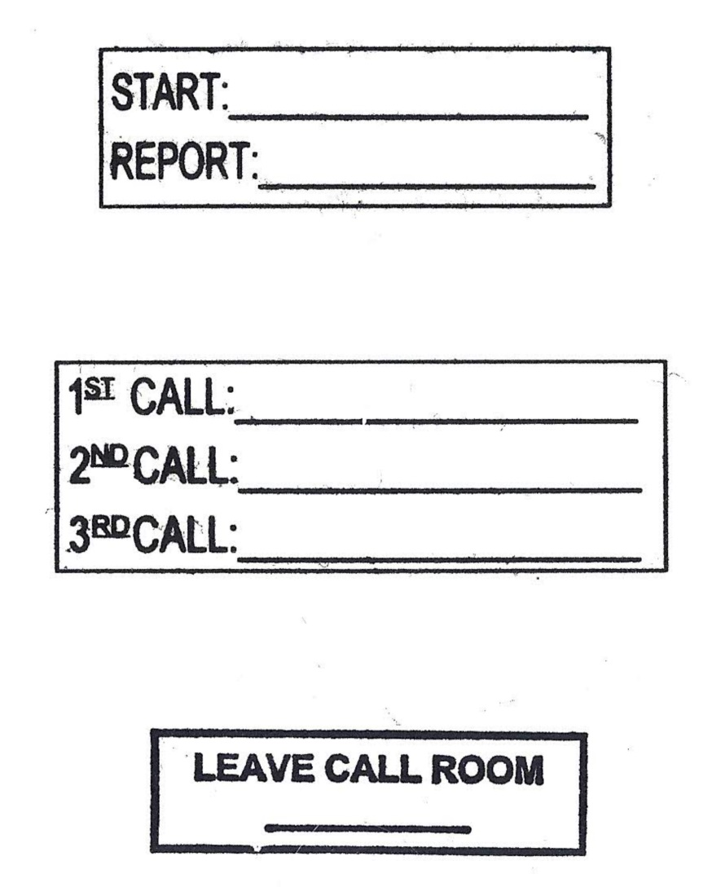
PROACTIVE CLERKING
Helpful Stamps

Slide 27
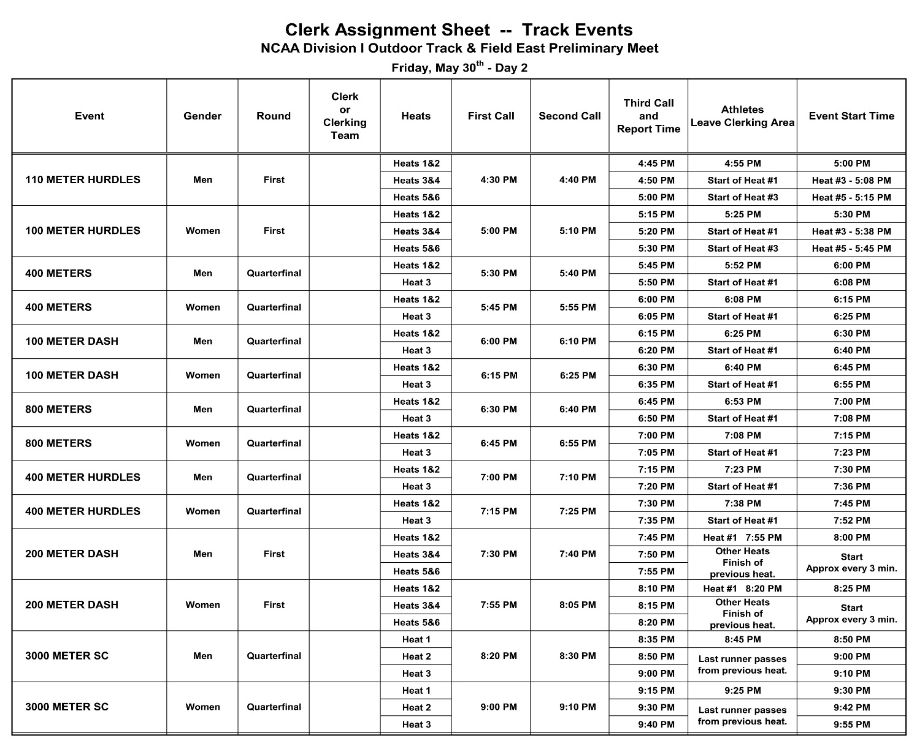
PROACTIVE CLERKING
Clerk Assignment Sheet

Slide 28
RESOURCES
USATF Monograph: The Clerk of Course: Guide to Clerking
USATF Best Practices:
  Clerk Head Official Protocols
  Duties and Tips
  Information, Equipment, and Track Markings
  Preparations for Major Meets
  Check-In and Staging Procedures and Instructions
  Clerk Assignment Sheets
  Clerking – Major Points under USATF and NCAA Rules
USATF Rule Book
NCAA Rule Book
Notes:
Clerk of Course

Slide 29

EFFICIENT CLERKING
QUESTIONS?
DISCUSSIONS!
Notes:
Clerk of Course

